Slide 1
Learning logs

Slide 2
What is a learning log?
A way of making home learning more creative, personal and fun!

Slide 3
Learning logs
Each log is a unique record of the child's thinking and learning.

Slide 4
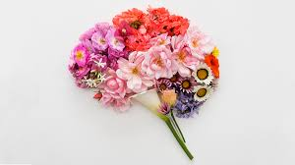
learning logs
A task will be set that is relevant to learning taking place in the classroom. Children are given the opportunity to respond to this in their own individual way and each Learning Log is unique.
The work needs to be well presented but the way that children choose to do this is entirely up to them. It might include written accounts, poetry, music, fold-out charts, pictures, diagrams, art, modelling, sculpture, baking etc. The children are in control!

Slide 5
How will feedback be given?
Feedback will be given by your child’s class teacher and returned to you in the log.

Slide 6
How often will my child have a task and how long should they spend on it?
A Learning Log task will be set each half term in connection with the theme being studied (a total of 6 throughout the year). 4 weeks will be given for the completion of each task.
When the completed logs are returned to school they will be shared as a class to enable the children to learn from each other. This will be known as ‘feedback week.’

Slide 7
How often will my child have a task and how long should they spend on it?
How long your child spends on their learning log will depend upon their personal level of investment to their learning log.

Slide 8
What might a learning log look like?
Each child will have an A4 book in which to record their responses to learning challenges set by their class teacher.
However, their response may of course extend beyond their A4 book.

Slide 9
LEARNING LOGS
Allow for individualism.
Allow you to see the inside world of the child.
They’re fun!
They are driven by the child and not the teacher.
They encourage creativity, collaboration and celebration of learning.

Slide 10
LEARNING LOGS
We look forward to the Goldfinch, Kingfisher and Skylark classes completing their first learning logs this half-term. Our Robins class will be joining in the fun next half-term.

Slide 11
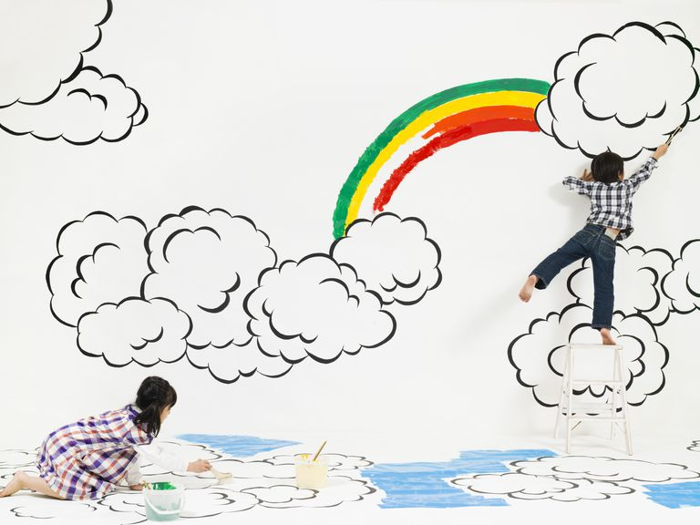
Enjoy!

Slide 12
Learning logs

